Slide 1

Financial Investment Chat BOT
Overview of Functionality and Intended Uses
Husein Adenwala

Slide 2
Introducing FINBOT
Specific user requested stock/company information
Instant glossary to find meaning of financial terms

Slide 3
PROBLEM DEFINITION
Identify the intents and the entities associated with a user’s input.
Retrieve information

Slide 4
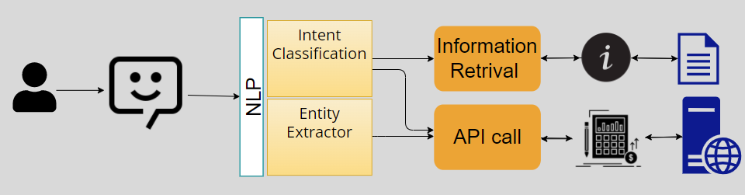
Methods NLP pipeline
Data
Taking all the combination of key terms (intent) and question start phrases to get 1196 documents for 18 intent classification.
170 documents for financial term definition.
Tokenize the data with minimal clean up.
LSTM with an embedding layer for intent classification
Spacy pretrained model Entity extraction
Each intent is mapped to a function
Function uses TFIDF cosine-similarity to retrieve information
Function makes an API call to retrieve stock/company data
what is the
can you please get
can you help me find
find the
find the of
please find
find the of
help me with
help me
buy, good stock, good buy, top stock, good investment
ratings, analyst rating, consensus , top rated
ratios, normalize ratio, performance data
Meaning , definition, means, define, mean

Slide 5

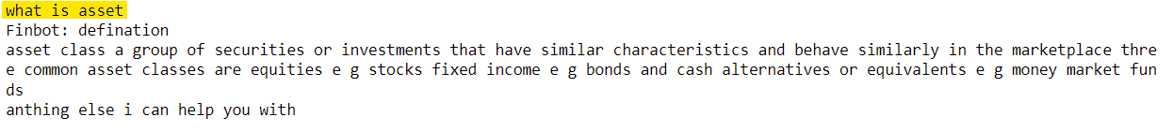


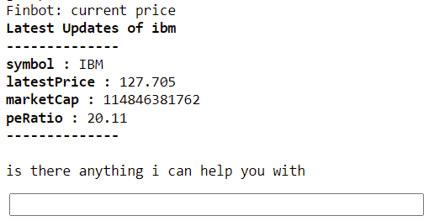

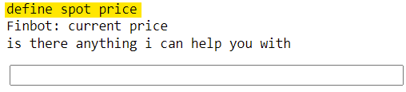
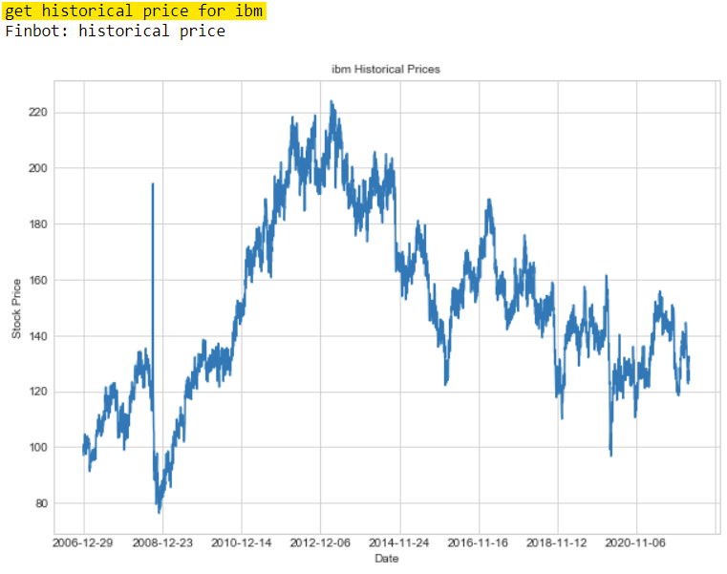
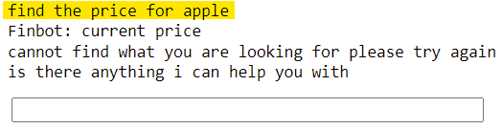
RESULTS
IEX Cloud API

Slide 6
CONCLUSION
Limitations with entity extraction
Reduce the number of intents
Fine-tune BERT for intent classification
Experiment with Word2Vec or Doc2vec

